Slide 1
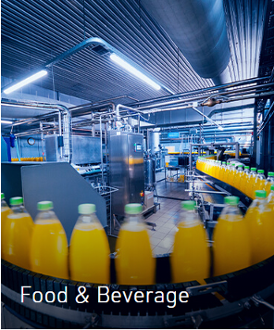
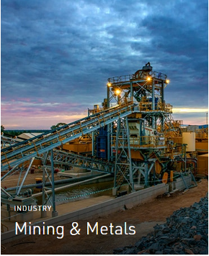

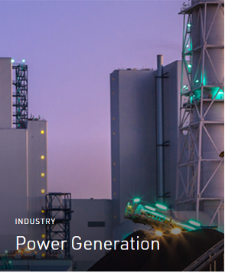
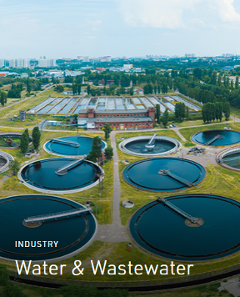
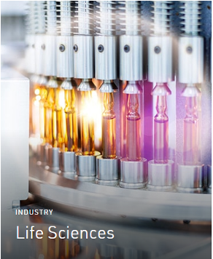
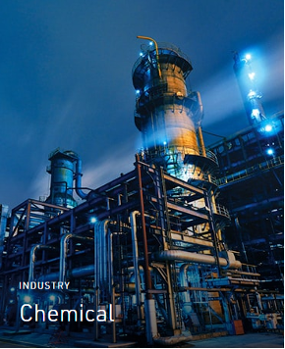
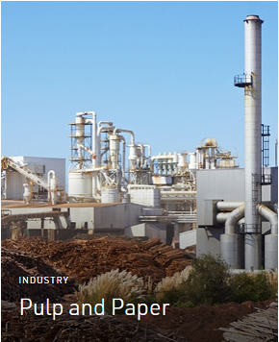
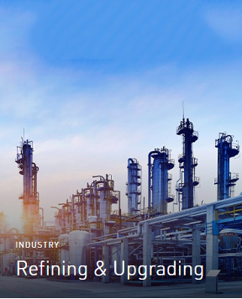
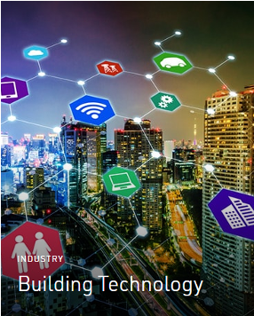
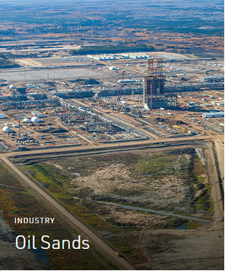

UPSTREAM
DOWNSTREAM
Automation Solutions
MIDSTREAM

Slide 2
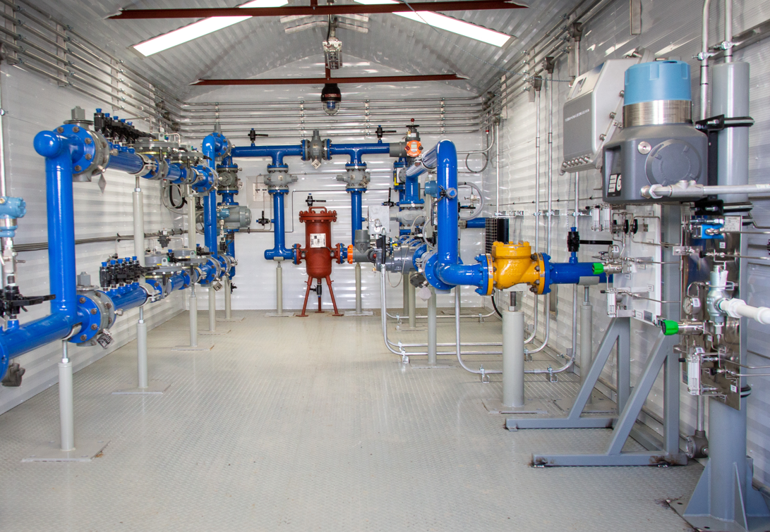
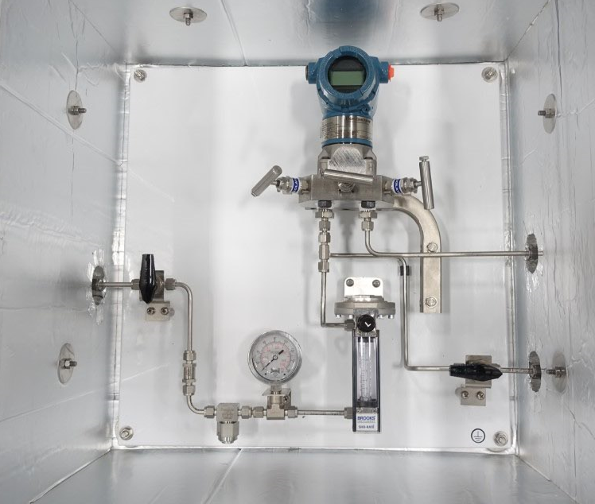
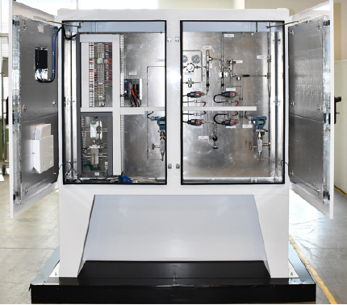
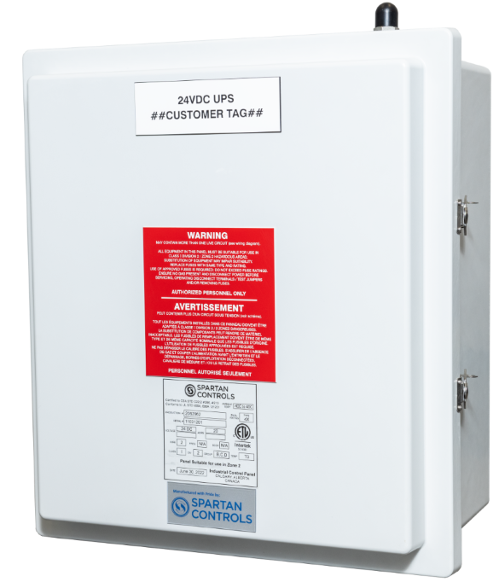
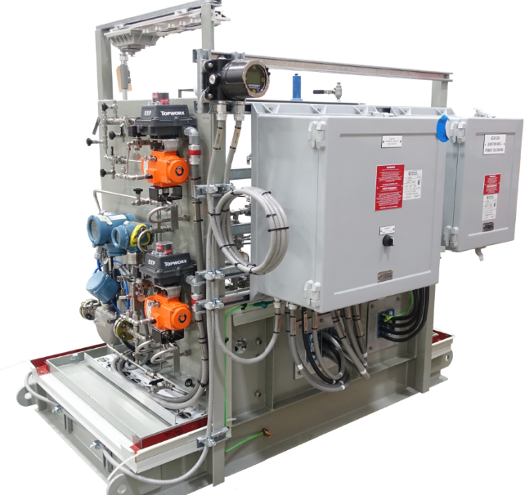
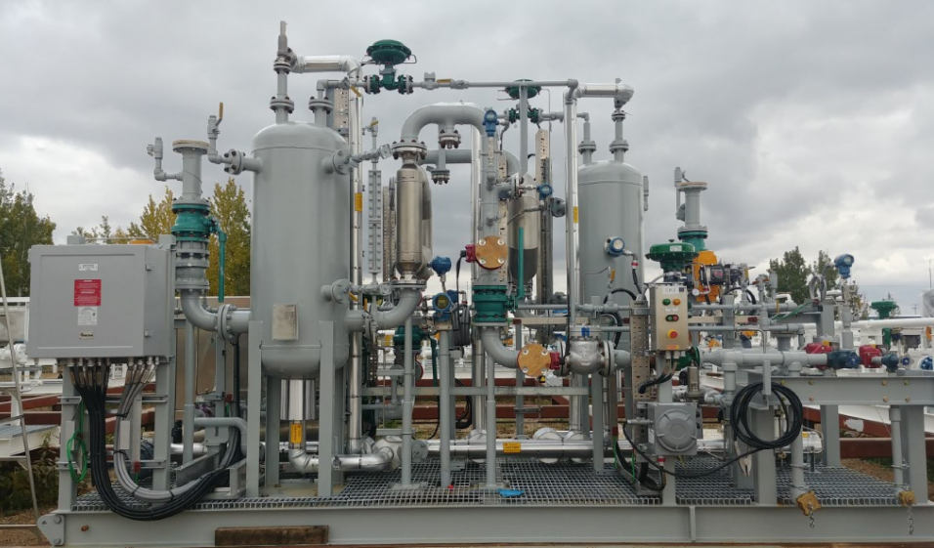
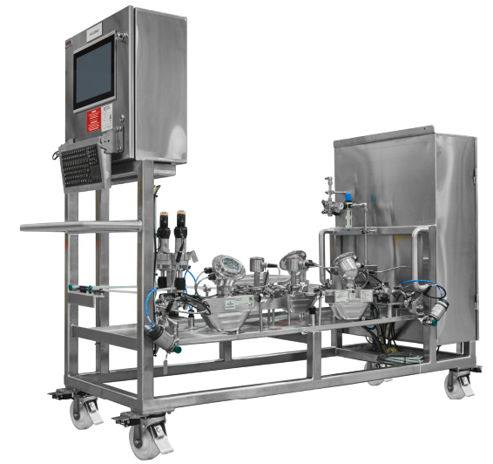
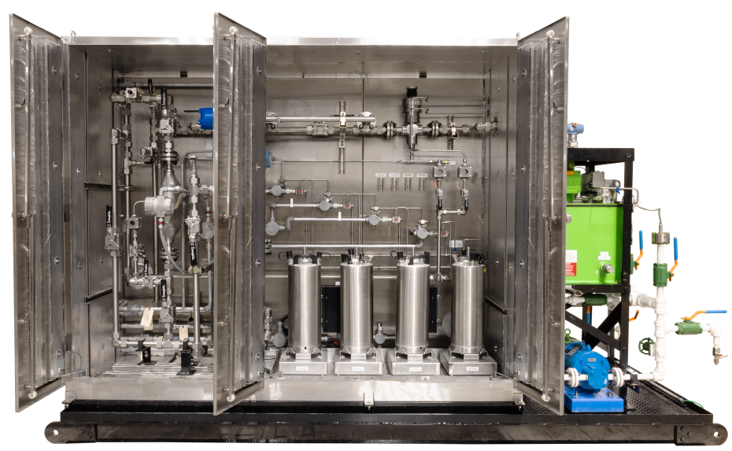
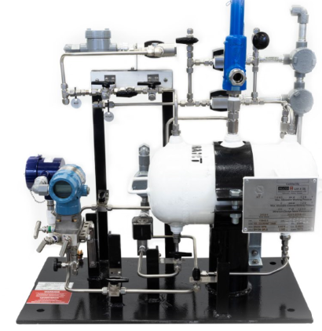
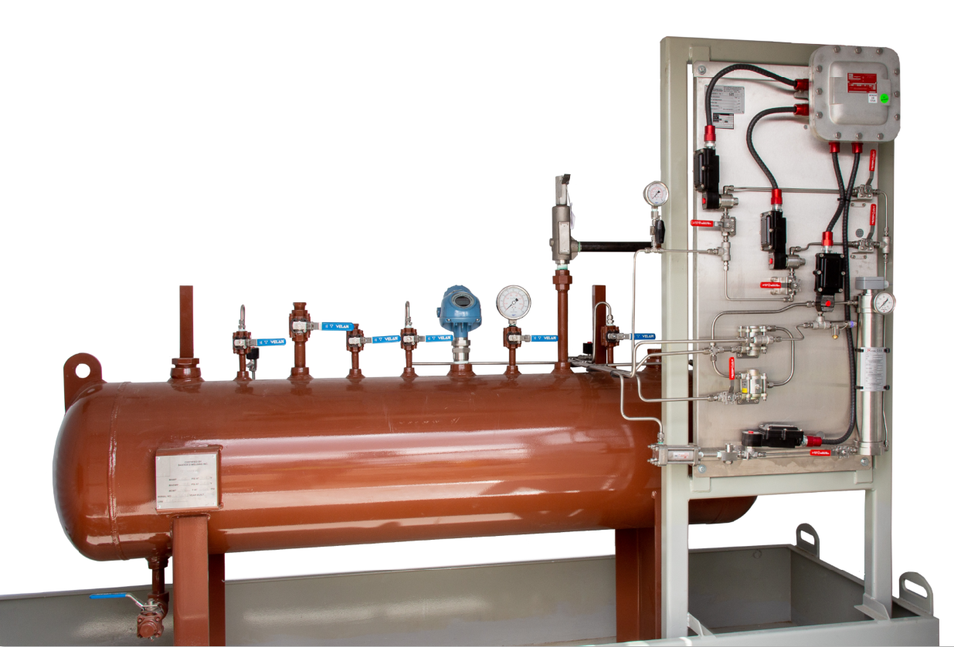
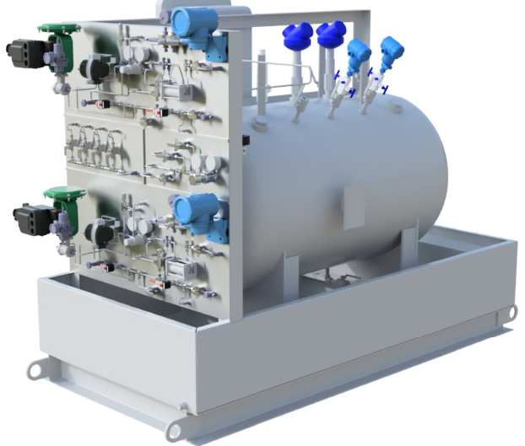
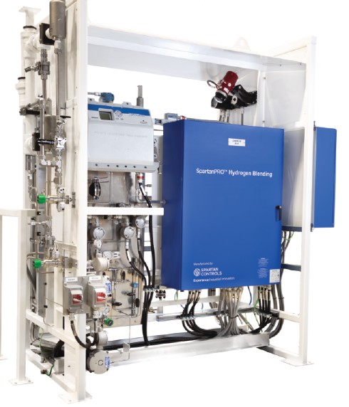
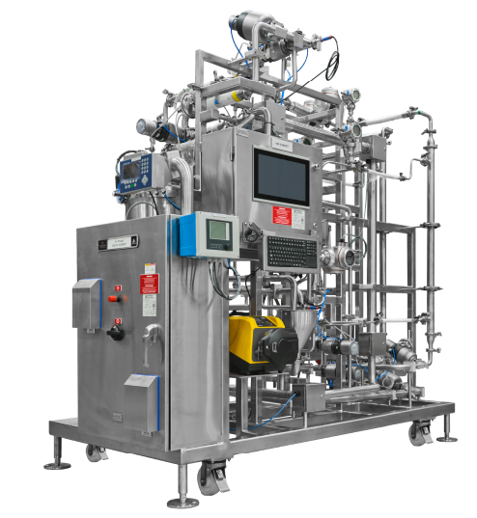
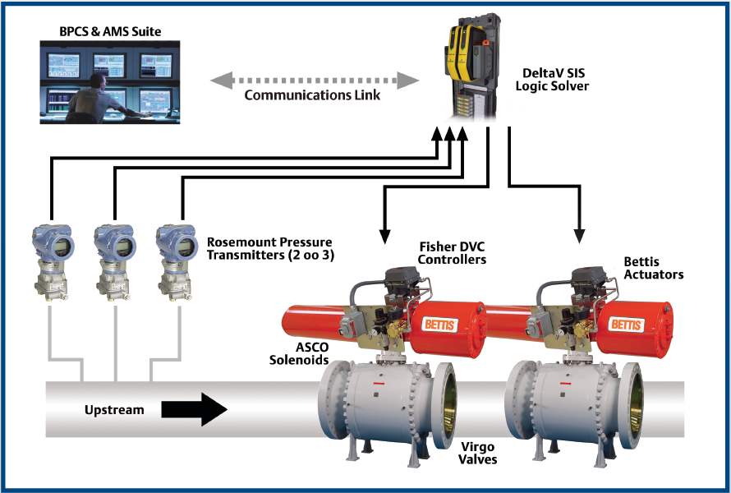
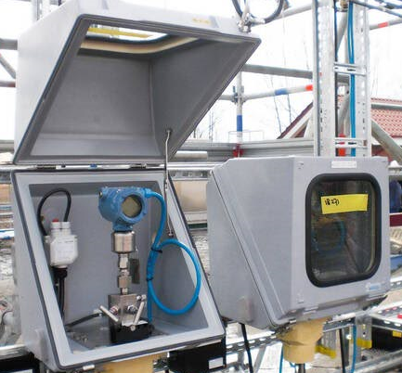
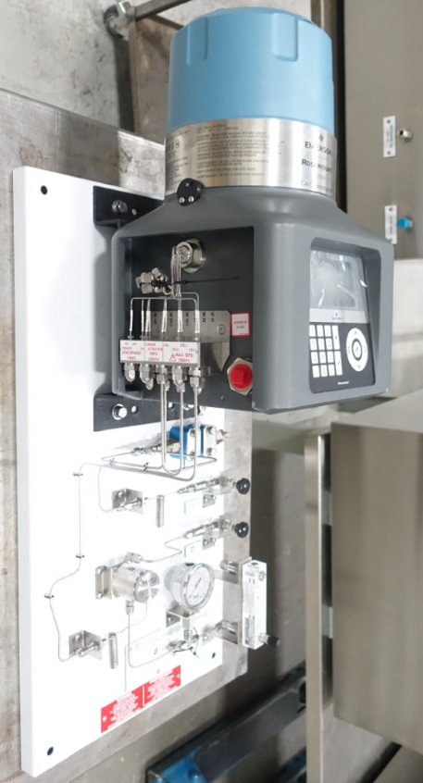
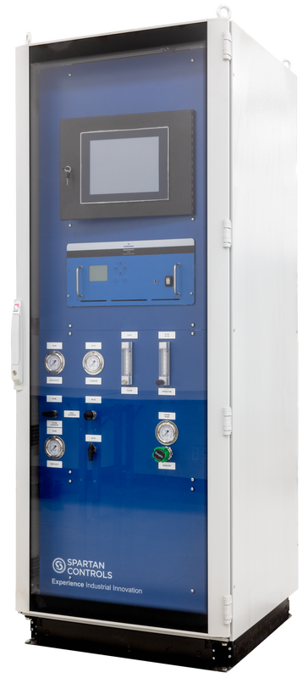
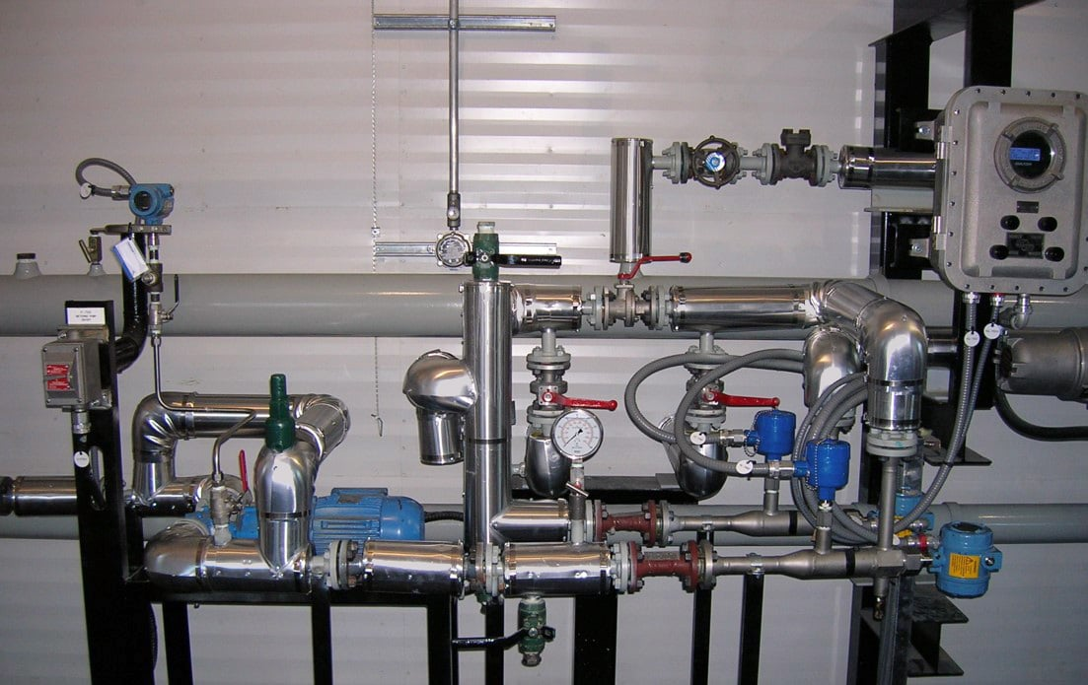
Automation Solutions
RNG
Upstream
Midstream
Downstream
Bubbler
SpartanPRO Surge
Truck/Rail Load/Unload
Valve UPS
IOTA-PI
Quality
Measurement
System
IOTA-PSU
mRNA-PF
IOTA-ABO
IOTA-PSU
IOTA-DP
IOTA-PT
Hydrogen Blending
mRNA-TFF
HIPPS
Winterization
Sample Conditioning
CEMS
SpartanPRO MultiViscosity

Slide 3







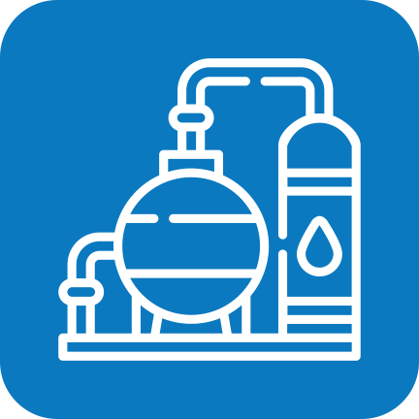

UPSTREAM
MIDSTREAM
DOWNSTREAM
REQUEST A QUOTE
LIFE
SCIENCES
OIL
POWER
GENERATION
PULP & PAPER
OIL & GAS
CHEMICAL
Quality Measurement System
HIPPS
Bubbler
Automated sample collection and measurements from flowing pipeline
Density, Viscosity and Water Cut measurements
High Integrity Pressure Protection System
Designed to close valves and isolate process when overpressure is detected
Liquid Level Measurement of more difficult type processes
Viscous fluids, slurries, sewage, liquids with suspended solids and sludge
OIL SANDS
REFINING &
UPGRADING
MINING &
METALS
Applications
Liquid Pipelines
Storage
Custody Transfer
Applications
Refineries
Petrochem Facilities
Power plants
Natural gas gathering
Storage
Applications
Open Top or Vented tanks
Wells
Wastewater
Can be used in place of Radar and Float
OIL & GAS
CHEMICAL
OIL & GAS
POWER
GENERATION
CHEMICAL
OIL & GAS
OIL SANDS
REFINING &
UPGRADING
CHEMICAL
MINING &
METALS

Slide 4
UPSTREAM
MIDSTREAM
DOWNSTREAM
REQUEST A QUOTE
LIFE
SCIENCES
OIL
POWER
GENERATION
PULP & PAPER
OIL & GAS
CHEMICAL
CEMS
Valve UPS
Winterization
Continuous Emissions Monitoring
Measures and reports pollutants emissions from industrial sources
Electric fail safe for Valves
Utilizes existing connections of a 24VDC electric actuator to charge the UPS
Winterizing to prevent the effects of low ambient temperatures
Rated for hazardous areas
Heated to maintain an internal temperature of 10 deg C
OIL SANDS
REFINING &
UPGRADING
MINING &
METALS
Applications
Refineries
Petrochem Facilities
Power plants
Cement Plants
Waste Incineration
Applications
Wherever an electric fail-last valve is required
Applications
Refineries
Petrochem Facilities
Power Plants
Natural Gas Gathering
Storage
OIL SANDS
OIL & GAS
CHEMICAL
OIL & GAS
REFINING &
UPGRADING
POWER
GENERATION
CHEMICAL
MINING &
METALS
REFINING &
UPGRADING
MINING &
METALS
PULP & PAPER
LIFE
SCIENCES
OIL SANDS
OIL & GAS
REFINING &
UPGRADING
PULP & PAPER
CHEMICAL
POWER
GENERATION

Slide 5
UPSTREAM
MIDSTREAM
DOWNSTREAM
REQUEST A QUOTE
LIFE
SCIENCES
OIL
POWER
GENERATION
PULP & PAPER
OIL & GAS
CHEMICAL
SpartanPRO Surge
SpartanPRO Multi-Viscosity
Highly accurate pressure control panel designed for the control of pipeline surge valves
Reduce operating costs by reducing nitrogen consumption
???
OIL SANDS
REFINING &
UPGRADING
MINING &
METALS
Applications
Liquid Pipelines
Refineries
Terminals
Marine Loading
Tank Farms
Applications
???
OIL & GAS
OIL & GAS

Slide 6
UPSTREAM
MIDSTREAM
DOWNSTREAM
REQUEST A QUOTE
LIFE
SCIENCES
OIL
POWER
GENERATION
PULP & PAPER
OIL & GAS
CHEMICAL
IOTA-ABO
IOTA-DP
IOTA-PI
ABO – Automated Bypass Odorizer
Odorant injection for lower flow applications
100,000 SCFH and under
Used in place of typical sweep systems
Zero vent unit
DP – Differential Pressure
Smart Odorizing system with solenoid valve injection technology
35,000 SCFH and above
Reliable and very low maintenance
Zero vent unit
PI – Pump Inject
Precise odorizing for high pressure, high flow applications
3mm up to 6.8mm SCFH
Pump based system
OIL SANDS
REFINING &
UPGRADING
MINING &
METALS
Applications
RMO Stations (Regulate, Monitor, Odorize)
Farms
Light Commercial
Applications
Gas Plants
RMO Stations (Regulate, Monitor, Odorize)
City Gate Stations, Larger Commercial
Applications
Gas Plants
Gas Fired Power Plants
Anywhere large quantities of gas are used that need to be odorized
OIL & GAS
OIL & GAS
POWER
GENERATION
OIL & GAS
POWER
GENERATION

Slide 7
UPSTREAM
MIDSTREAM
DOWNSTREAM
REQUEST A QUOTE
IOTA-PSU
LIFE
SCIENCES
OIL
POWER
GENERATION
PULP & PAPER
OIL & GAS
CHEMICAL
IOTA-PSU
IOTA-PT
Hydrogen Blending
PSU – Pipe Saturation Unit
Smart Odorizing system with solenoid valve injection technology
35,000 SCFH and above
Reliable and very low maintenance
Zero vent unit
PT – Pressurized Tank
Batch and/or continuous odorant injection
35,000 SCFH and above
Zero vent unit
Blending hydrogen into flowing gas streams from 0 -20% concentration
Concentration verified by an online analyzer
Compensates automatically for accurate blending
OIL SANDS
REFINING &
UPGRADING
MINING &
METALS
Applications
This unit will saturate pipelines with odorant to avoid under odorizing new installations
Applications
Gas Plants
RMO Stations (Regulate, Monitor, Odorize)
City Gate Stations, Larger Commercial
Applications
Petrochem
Gas Distribution
Transportation
Most anywhere natural gas is used
OIL & GAS
POWER
GENERATION
OIL & GAS
POWER
GENERATION
OIL & GAS
POWER
GENERATION
REFINING &
UPGRADING

Slide 8
UPSTREAM
MIDSTREAM
DOWNSTREAM
REQUEST A QUOTE
LIFE
SCIENCES
OIL
POWER
GENERATION
PULP & PAPER
OIL & GAS
CHEMICAL
Sample Conditioning
Truck/Rail Load/Unload
Used upstream of an analyzer to clean up the sample to a state that can be safely accepted by the analyzer
Safely loading and unloading process fluids on and off trucks and rail cars
Water, oil, condensate measurements
Total volume
Trucker permissions
OIL SANDS
REFINING &
UPGRADING
MINING &
METALS
Applications
Gas Process Sampling
Temperature Control
Pressure Control
Fast Loop and Multi-stream
Applications
Storage
Custody Transfer
Pipelines
Well sites
NGL
OIL & GAS
REFINING &
UPGRADING
CHEMICAL
POWER
GENERATION
LIFE
SCIENCES
OIL & GAS

Slide 9
UPSTREAM
MIDSTREAM
DOWNSTREAM
REQUEST A QUOTE
LIFE
SCIENCES
OIL
POWER
GENERATION
PULP & PAPER
OIL & GAS
CHEMICAL
RNG
Intakes renewable natural gas
Measures, analyzes and odorizes
Sends to distribution
Returns gas if out of spec
OIL SANDS
REFINING &
UPGRADING
MINING &
METALS
Applications
Gas Distribution
Power Generation
OIL & GAS

Slide 10
UPSTREAM
MIDSTREAM
DOWNSTREAM
REQUEST A QUOTE
LIFE
SCIENCES
OIL
POWER
GENERATION
PULP & PAPER
OIL & GAS
CHEMICAL
mRNA-PF
mRNA-TFF
Particle Formation system
mRNA and Lipids are pumped into the mixing chamber where they are combined at specific rates and geometries for Liquid Nanoparticle Formations (LNP)
Tangential Flow Filtration
Product from the PF is filtered in the TFF by a specialized hollow fiber filter specific to mRNA-LNP applications
OIL SANDS
REFINING &
UPGRADING
MINING &
METALS
Applications
Tailored for small scale production, such as immuno-oncolytic applications or targeted cellular therapies
Large scale production such as mRNA vaccine manufacturing
Applications
Tailored for small scale production, such as immuno-oncolytic applications or targeted cellular therapies
Large scale production such as mRNA vaccine manufacturing
LIFE
SCIENCES
LIFE
SCIENCES

Slide 11
Upstream Solutions
Bubbler
SpartanPRO Surge
Quality
Measurement
System
Valve UPS
Winterization
SpartanPRO MultiViscosity
HIPPS
CEMS

Slide 12
UPSTREAM
REQUEST A QUOTE
LIFE
SCIENCES
OIL
POWER
GENERATION
PULP & PAPER
OIL & GAS
CHEMICAL
Quality Measurement System
HIPPS
Bubbler
Automated sample collection and measurements from flowing pipeline
Density, Viscosity and Water Cut measurements
High Integrity Pressure Protection System
Designed to close valves and isolate process when overpressure is detected
Liquid Level Measurement of more difficult type processes
Viscous fluids, slurries, sewage, liquids with suspended solids and sludge
OIL SANDS
REFINING &
UPGRADING
MINING &
METALS
Applications
Liquid Pipelines
Storage
Custody Transfer
Applications
Refineries
Petrochem Facilities
Power plants
Natural gas gathering
Storage
Applications
Open Top or Vented tanks
Wells
Wastewater
Can be used in place of Radar and Float
OIL & GAS
CHEMICAL
OIL & GAS
POWER
GENERATION
CHEMICAL
OIL & GAS
OIL SANDS
REFINING &
UPGRADING
CHEMICAL
MINING &
METALS

Slide 13
UPSTREAM
REQUEST A QUOTE
LIFE
SCIENCES
OIL
POWER
GENERATION
PULP & PAPER
OIL & GAS
CHEMICAL
CEMS
Valve UPS
Winterization
Continuous Emissions Monitoring
Measures and reports pollutants emissions from industrial sources
Electric fail safe for Valves
Utilizes existing connections of a 24VDC electric actuator to charge the UPS
Winterizing to prevent the effects of low ambient temperatures
Rated for hazardous areas
Heated to maintain an internal temperature of 10 deg C
OIL SANDS
REFINING &
UPGRADING
MINING &
METALS
Applications
Refineries
Petrochem Facilities
Power plants
Cement Plants
Waste Incineration
Applications
Wherever an electric fail-last valve is required
Applications
Refineries
Petrochem Facilities
Power Plants
Natural Gas Gathering
Storage
OIL SANDS
OIL & GAS
CHEMICAL
OIL & GAS
REFINING &
UPGRADING
POWER
GENERATION
CHEMICAL
MINING &
METALS
REFINING &
UPGRADING
MINING &
METALS
PULP & PAPER
LIFE
SCIENCES
OIL SANDS
OIL & GAS
REFINING &
UPGRADING
PULP & PAPER
CHEMICAL
POWER
GENERATION

Slide 14
UPSTREAM
REQUEST A QUOTE
LIFE
SCIENCES
OIL
POWER
GENERATION
PULP & PAPER
OIL & GAS
CHEMICAL
SpartanPRO Surge
SpartanPRO Multi-Viscosity
Highly accurate pressure control panel designed for the control of pipeline surge valves
Reduce operating costs by reducing nitrogen consumption
???
OIL SANDS
REFINING &
UPGRADING
MINING &
METALS
Applications
Liquid Pipelines
Refineries
Terminals
Marine Loading
Tank Farms
Applications
???
OIL & GAS
OIL & GAS

Slide 15
Midstream Solutions
RNG
Truck/Rail Load/Unload
Bubbler
SpartanPRO Surge
Valve UPS
IOTA-PI
Quality
Measurement
System
IOTA-PSU
IOTA-ABO
IOTA-PSU
IOTA-DP
IOTA-PT
Hydrogen Blending
HIPPS
Winterization
Sample Conditioning
CEMS
SpartanPRO MultiViscosity

Slide 16
MIDSTREAM
REQUEST A QUOTE
LIFE
SCIENCES
OIL
POWER
GENERATION
PULP & PAPER
OIL & GAS
CHEMICAL
Quality Measurement System
HIPPS
Bubbler
Automated sample collection and measurements from flowing pipeline
Density, Viscosity and Water Cut measurements
High Integrity Pressure Protection System
Designed to close valves and isolate process when overpressure is detected
Liquid Level Measurement of more difficult type processes
Viscous fluids, slurries, sewage, liquids with suspended solids and sludge
OIL SANDS
REFINING &
UPGRADING
MINING &
METALS
Applications
Liquid Pipelines
Storage
Custody Transfer
Applications
Refineries
Petrochem Facilities
Power plants
Natural gas gathering
Storage
Applications
Open Top or Vented tanks
Wells
Wastewater
Can be used in place of Radar and Float
OIL & GAS
CHEMICAL
OIL & GAS
POWER
GENERATION
CHEMICAL
OIL & GAS
OIL SANDS
REFINING &
UPGRADING
CHEMICAL
MINING &
METALS

Slide 17
MIDSTREAM
REQUEST A QUOTE
LIFE
SCIENCES
OIL
POWER
GENERATION
PULP & PAPER
OIL & GAS
CHEMICAL
CEMS
Valve UPS
Winterization
Continuous Emissions Monitoring
Measures and reports pollutants emissions from industrial sources
Electric fail safe for Valves
Utilizes existing connections of a 24VDC electric actuator to charge the UPS
Winterizing to prevent the effects of low ambient temperatures
Rated for hazardous areas
Heated to maintain an internal temperature of 10 deg C
OIL SANDS
REFINING &
UPGRADING
MINING &
METALS
Applications
Refineries
Petrochem Facilities
Power plants
Cement Plants
Waste Incineration
Applications
Wherever an electric fail-last valve is required
Applications
Refineries
Petrochem Facilities
Power Plants
Natural Gas Gathering
Storage
OIL SANDS
OIL & GAS
CHEMICAL
OIL & GAS
REFINING &
UPGRADING
POWER
GENERATION
CHEMICAL
MINING &
METALS
REFINING &
UPGRADING
MINING &
METALS
PULP & PAPER
LIFE
SCIENCES
OIL SANDS
OIL & GAS
REFINING &
UPGRADING
PULP & PAPER
CHEMICAL
POWER
GENERATION

Slide 18
MIDSTREAM
REQUEST A QUOTE
LIFE
SCIENCES
OIL
POWER
GENERATION
PULP & PAPER
OIL & GAS
CHEMICAL
SpartanPRO Surge
SpartanPRO Multi-Viscosity
Highly accurate pressure control panel designed for the control of pipeline surge valves
Reduce operating costs by reducing nitrogen consumption
???
OIL SANDS
REFINING &
UPGRADING
MINING &
METALS
Applications
Liquid Pipelines
Refineries
Terminals
Marine Loading
Tank Farms
Applications
???
OIL & GAS
OIL & GAS

Slide 19
MIDSTREAM
REQUEST A QUOTE
LIFE
SCIENCES
OIL
POWER
GENERATION
PULP & PAPER
OIL & GAS
CHEMICAL
IOTA-ABO
IOTA-DP
IOTA-PI
ABO – Automated Bypass Odorizer
Odorant injection for lower flow applications
100,000 SCFH and under
Used in place of typical sweep systems
Zero vent unit
DP – Differential Pressure
Smart Odorizing system with solenoid valve injection technology
35,000 SCFH and above
Reliable and very low maintenance
Zero vent unit
PI – Pump Inject
Precise odorizing for high pressure, high flow applications
3mm up to 6.8mm SCFH
Pump based system
OIL SANDS
REFINING &
UPGRADING
MINING &
METALS
Applications
RMO Stations (Regulate, Monitor, Odorize)
Farms
Light Commercial
Applications
Gas Plants
RMO Stations (Regulate, Monitor, Odorize)
City Gate Stations, Larger Commercial
Applications
Gas Plants
Gas Fired Power Plants
Anywhere large quantities of gas are used that need to be odorized
OIL & GAS
OIL & GAS
POWER
GENERATION
OIL & GAS
POWER
GENERATION

Slide 20
MIDSTREAM
REQUEST A QUOTE
IOTA-PSU
LIFE
SCIENCES
OIL
POWER
GENERATION
PULP & PAPER
OIL & GAS
CHEMICAL
IOTA-PSU
IOTA-PT
Hydrogen Blending
PSU – Pipe Saturation Unit
Smart Odorizing system with solenoid valve injection technology
35,000 SCFH and above
Reliable and very low maintenance
Zero vent unit
PT – Pressurized Tank
Batch and/or continuous odorant injection
35,000 SCFH and above
Zero vent unit
Blending hydrogen into flowing gas streams from 0 -20% concentration
Concentration verified by an online analyzer
Compensates automatically for accurate blending
OIL SANDS
REFINING &
UPGRADING
MINING &
METALS
Applications
This unit will saturate pipelines with odorant to avoid under odorizing new installations
Applications
Gas Plants
RMO Stations (Regulate, Monitor, Odorize)
City Gate Stations, Larger Commercial
Applications
Petrochem
Gas Distribution
Transportation
Most anywhere natural gas is used
OIL & GAS
POWER
GENERATION
OIL & GAS
POWER
GENERATION
OIL & GAS
POWER
GENERATION
REFINING &
UPGRADING

Slide 21
MIDSTREAM
REQUEST A QUOTE
LIFE
SCIENCES
OIL
POWER
GENERATION
PULP & PAPER
OIL & GAS
CHEMICAL
Sample Conditioning
Truck/Rail Load/Unload
Used upstream of an analyzer to clean up the sample to a state that can be safely accepted by the analyzer
Safely loading and unloading process fluids on and off trucks and rail cars
Water, oil, condensate measurements
Total volume
Trucker permissions
OIL SANDS
REFINING &
UPGRADING
MINING &
METALS
Applications
Gas Process Sampling
Temperature Control
Pressure Control
Fast Loop and Multi-stream
Applications
Storage
Custody Transfer
Pipelines
Well sites
NGL
OIL & GAS
REFINING &
UPGRADING
CHEMICAL
POWER
GENERATION
LIFE
SCIENCES
OIL & GAS

Slide 22
MIDSTREAM
REQUEST A QUOTE
LIFE
SCIENCES
OIL
POWER
GENERATION
PULP & PAPER
OIL & GAS
CHEMICAL
RNG
Intakes renewable natural gas
Measures, analyzes and odorizes
Sends to distribution
Returns gas if out of spec
OIL SANDS
REFINING &
UPGRADING
MINING &
METALS
Applications
Gas Distribution
Power Generation
OIL & GAS

Slide 23
Downstream Solutions
Truck/Rail Load/Unload
Bubbler
Valve UPS
IOTA-PI
Quality
Measurement
System
IOTA-PSU
IOTA-ABO
IOTA-PSU
IOTA-DP
IOTA-PT
Hydrogen Blending
HIPPS
Winterization
Sample Conditioning
CEMS

Slide 24
DOWNSTREAM
REQUEST A QUOTE
LIFE
SCIENCES
OIL
POWER
GENERATION
PULP & PAPER
OIL & GAS
CHEMICAL
Quality Measurement System
HIPPS
Bubbler
Automated sample collection and measurements from flowing pipeline
Density, Viscosity and Water Cut measurements
High Integrity Pressure Protection System
Designed to close valves and isolate process when overpressure is detected
Liquid Level Measurement of more difficult type processes
Viscous fluids, slurries, sewage, liquids with suspended solids and sludge
OIL SANDS
REFINING &
UPGRADING
MINING &
METALS
Applications
Liquid Pipelines
Storage
Custody Transfer
Applications
Refineries
Petrochem Facilities
Power plants
Natural gas gathering
Storage
Applications
Open Top or Vented tanks
Wells
Wastewater
Can be used in place of Radar and Float
OIL & GAS
CHEMICAL
OIL & GAS
POWER
GENERATION
CHEMICAL
OIL & GAS
OIL SANDS
REFINING &
UPGRADING
CHEMICAL
MINING &
METALS

Slide 25
DOWNSTREAM
REQUEST A QUOTE
LIFE
SCIENCES
OIL
POWER
GENERATION
PULP & PAPER
OIL & GAS
CHEMICAL
CEMS
Valve UPS
Winterization
Continuous Emissions Monitoring
Measures and reports pollutants emissions from industrial sources
Electric fail safe for Valves
Utilizes existing connections of a 24VDC electric actuator to charge the UPS
Winterizing to prevent the effects of low ambient temperatures
Rated for hazardous areas
Heated to maintain an internal temperature of 10 deg C
OIL SANDS
REFINING &
UPGRADING
MINING &
METALS
Applications
Refineries
Petrochem Facilities
Power plants
Cement Plants
Waste Incineration
Applications
Wherever an electric fail-last valve is required
Applications
Refineries
Petrochem Facilities
Power Plants
Natural Gas Gathering
Storage
OIL SANDS
OIL & GAS
CHEMICAL
OIL & GAS
REFINING &
UPGRADING
POWER
GENERATION
CHEMICAL
MINING &
METALS
REFINING &
UPGRADING
MINING &
METALS
PULP & PAPER
LIFE
SCIENCES
OIL SANDS
OIL & GAS
REFINING &
UPGRADING
PULP & PAPER
CHEMICAL
POWER
GENERATION

Slide 26
DOWNSTREAM
REQUEST A QUOTE
LIFE
SCIENCES
OIL
POWER
GENERATION
PULP & PAPER
OIL & GAS
CHEMICAL
IOTA-ABO
IOTA-DP
IOTA-PI
ABO – Automated Bypass Odorizer
Odorant injection for lower flow applications
100,000 SCFH and under
Used in place of typical sweep systems
Zero vent unit
DP – Differential Pressure
Smart Odorizing system with solenoid valve injection technology
35,000 SCFH and above
Reliable and very low maintenance
Zero vent unit
PI – Pump Inject
Precise odorizing for high pressure, high flow applications
3mm up to 6.8mm SCFH
Pump based system
OIL SANDS
REFINING &
UPGRADING
MINING &
METALS
Applications
RMO Stations (Regulate, Monitor, Odorize)
Farms
Light Commercial
Applications
Gas Plants
RMO Stations (Regulate, Monitor, Odorize)
City Gate Stations, Larger Commercial
Applications
Gas Plants
Gas Fired Power Plants
Anywhere large quantities of gas are used that need to be odorized
OIL & GAS
OIL & GAS
POWER
GENERATION
OIL & GAS
POWER
GENERATION

Slide 27
DOWNSTREAM
REQUEST A QUOTE
IOTA-PSU
LIFE
SCIENCES
OIL
POWER
GENERATION
PULP & PAPER
OIL & GAS
CHEMICAL
IOTA-PSU
IOTA-PT
Hydrogen Blending
PSU – Pipe Saturation Unit
Smart Odorizing system with solenoid valve injection technology
35,000 SCFH and above
Reliable and very low maintenance
Zero vent unit
PT – Pressurized Tank
Batch and/or continuous odorant injection
35,000 SCFH and above
Zero vent unit
Blending hydrogen into flowing gas streams from 0 -20% concentration
Concentration verified by an online analyzer
Compensates automatically for accurate blending
OIL SANDS
REFINING &
UPGRADING
MINING &
METALS
Applications
This unit will saturate pipelines with odorant to avoid under odorizing new installations
Applications
Gas Plants
RMO Stations (Regulate, Monitor, Odorize)
City Gate Stations, Larger Commercial
Applications
Petrochem
Gas Distribution
Transportation
Most anywhere natural gas is used
OIL & GAS
POWER
GENERATION
OIL & GAS
POWER
GENERATION
OIL & GAS
POWER
GENERATION
REFINING &
UPGRADING

Slide 28
DOWNSTREAM
REQUEST A QUOTE
LIFE
SCIENCES
OIL
POWER
GENERATION
PULP & PAPER
OIL & GAS
CHEMICAL
Sample Conditioning
Truck/Rail Load/Unload
Used upstream of an analyzer to clean up the sample to a state that can be safely accepted by the analyzer
Safely loading and unloading process fluids on and off trucks and rail cars
Water, oil, condensate measurements
Total volume
Trucker permissions
OIL SANDS
REFINING &
UPGRADING
MINING &
METALS
Applications
Gas Process Sampling
Temperature Control
Pressure Control
Fast Loop and Multi-stream
Applications
Storage
Custody Transfer
Pipelines
Well sites
NGL
OIL & GAS
REFINING &
UPGRADING
CHEMICAL
POWER
GENERATION
LIFE
SCIENCES
OIL & GAS

