Slide 1
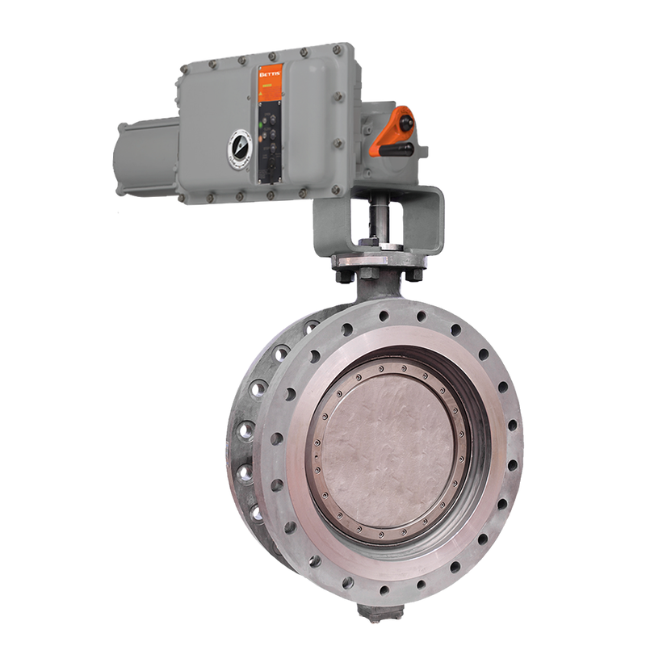
Transforming MOV Performance with Data‑Driven Diagnostics
A STRUCTURED APPROACH TO MITIGATING RISK AND IMPROVING LIFECYCLE PERFORMANCE
Challenge
Solution
Motor‑operated valves (MOVs) play a critical role in ensuring safe, reliable, and efficient operations.
Many large energy producers, particularly those operating in upstream, oilsands, and refining environments face ongoing challenges with ageing, non‑smart MOV installed base.
This often leads to reactive maintenance, limited visibility into asset health, and uncertainty about whether valves are performing as intended.
A common challenge is determining which assets truly require attention when there is no consistent diagnostic baseline or standardized assessment process.
Spartan implemented a structured MOV diagnostic program using FlowScanner technology to capture detailed performance data across the electric actuation install base.
This approach helps teams establish clear health baselines, identify developing issues early, and create alignment across departments using shared, data‑driven insights.
Value
Centralized Asset Data: A unified platform for collecting, storing, and analyzing MOV data, driving consistency across teams.
Failure Prevention Through Insight: Early identification of abnormal operating patterns, enabling proactive action before failures impact safety or production.
Better Lifecycle Decisions: Clear visibility into performance trends and wear indicators supports informed decisions on repair, overhaul, and replacement planning, reducing uncertainty and budget surprises.

